Slide 1
A data-driven method to identify frequency boundaries in multichannel electrophysiology data | Cohen, Journal of Neuroscience Methods, 2021
StepUp Journal Club
15th February 2023

Slide 2

author
Location | Research Area | H-Index
PI Donders Neuroinformatics | -Theta and cognitive control - LFP & single unit | 119 Analyzing neural time series data: theory and practice (~2100)

Slide 3
intro
Methods focused paper
Define boundaries of frequency bands in multichannel electrophysiological data (e.g. beta)
Works on individual data
Not covered today:
Regularization methods
Clustering in depth

Slide 4
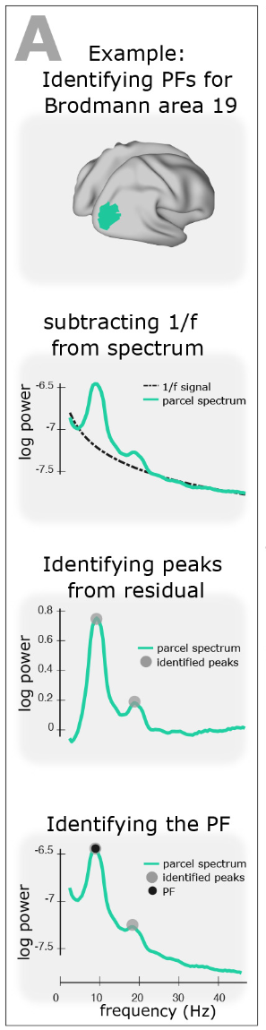
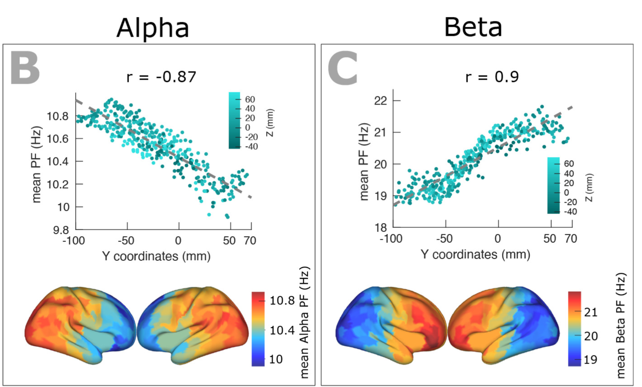
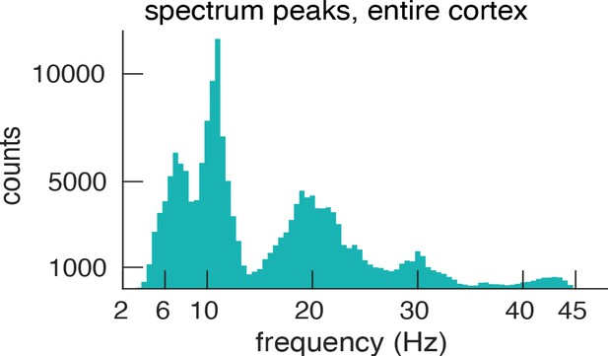
Frequency bands
Mahjoory ea., eLife, 2020
Notes:
Resting state MEG n=187
A: Estimating the power spectrum for each cortical region, and identifying peak frequencies after fitting and subtracting the arrhythmic 1/f component.
B & C: Dependency between the trimmed mean of band-specific PF (187 participants, 384 ROIs) and the ROI’s location along the y-axis (posterior to anterior) for theta (r = 0.4, p<0.001), alpha (r = 0.87, p<0.001), and beta (r = 0.9, p<0.001) bands, respectively. Points are colored according to their Z coordinates.

Slide 5
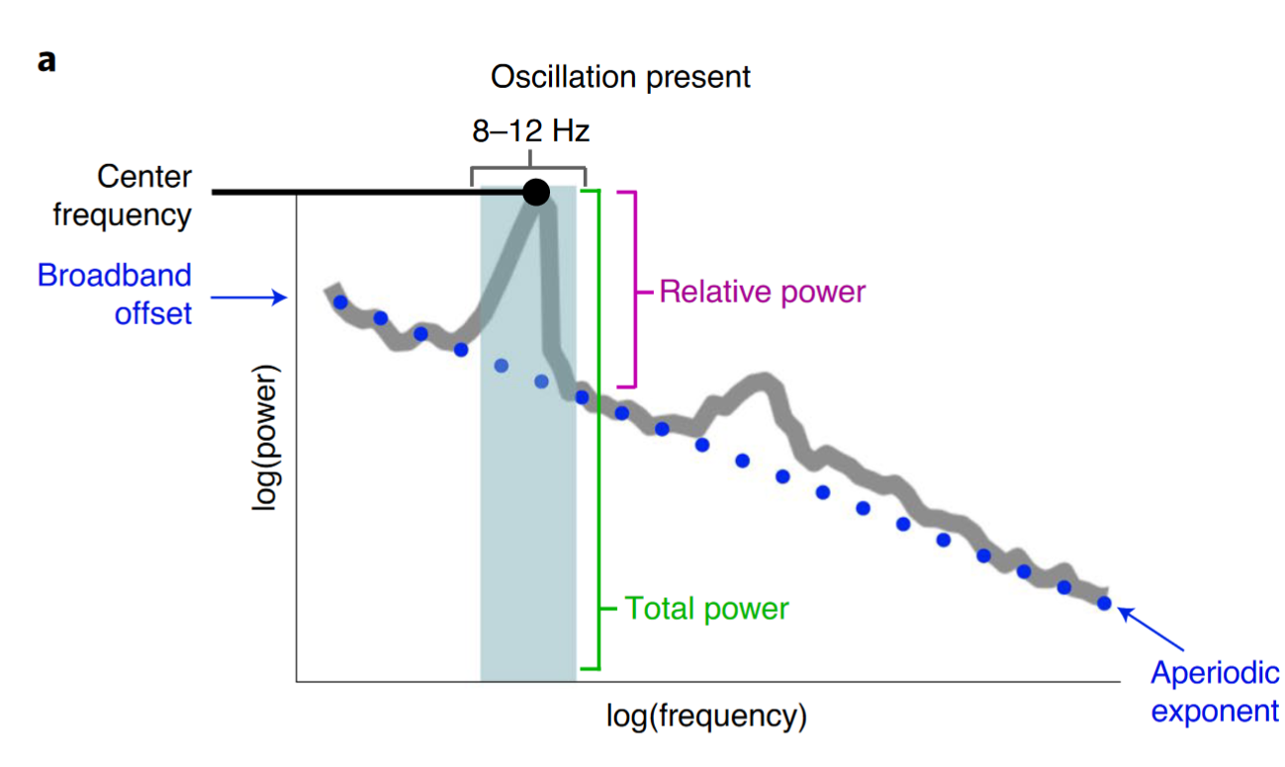
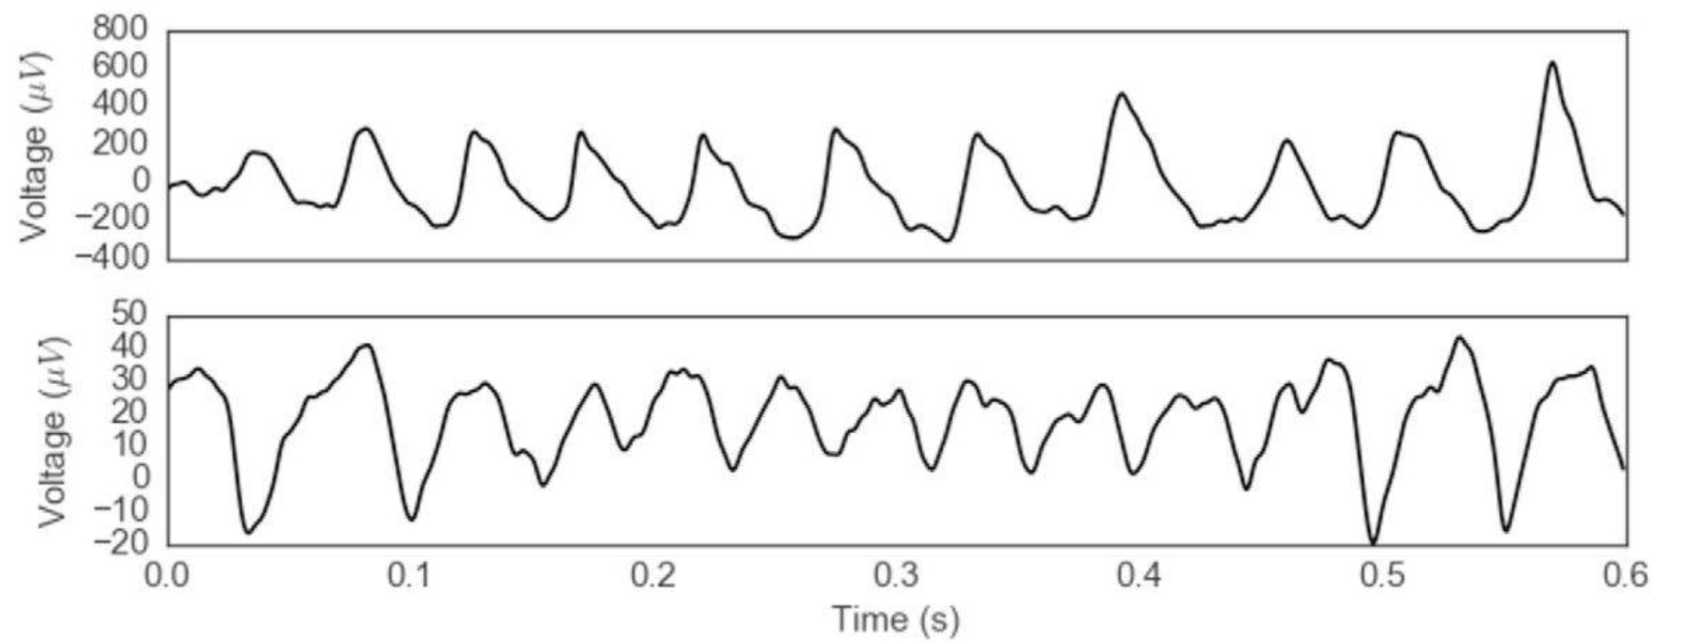
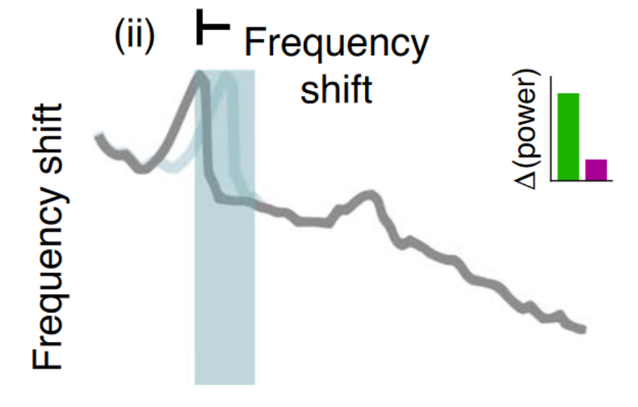
Motivation
“[…] existing methods of empirically detecting frequencies rely on the peaks, typically from individual channels […]”
https://bycycle-tools.github.io/bycycle/index.html
Cole ea., J.Neuroscience, 2017; Donoghue ea., Nature Neuroscience, 2020
Notes:
Example voltage traces from 2 patients corresponding to the sawtooth waveforms in quadrants I and III. These waveform shapes are consistent with the dark gray, but not the light gray, sawtooth shapes in
A: Example neural power spectrum with a strong alpha peak in the canonical frequency range (8–12 Hz, blue-shaded region) and secondary beta peak (not marked). b, Same as a, but with the alpha peak removed.

Slide 6
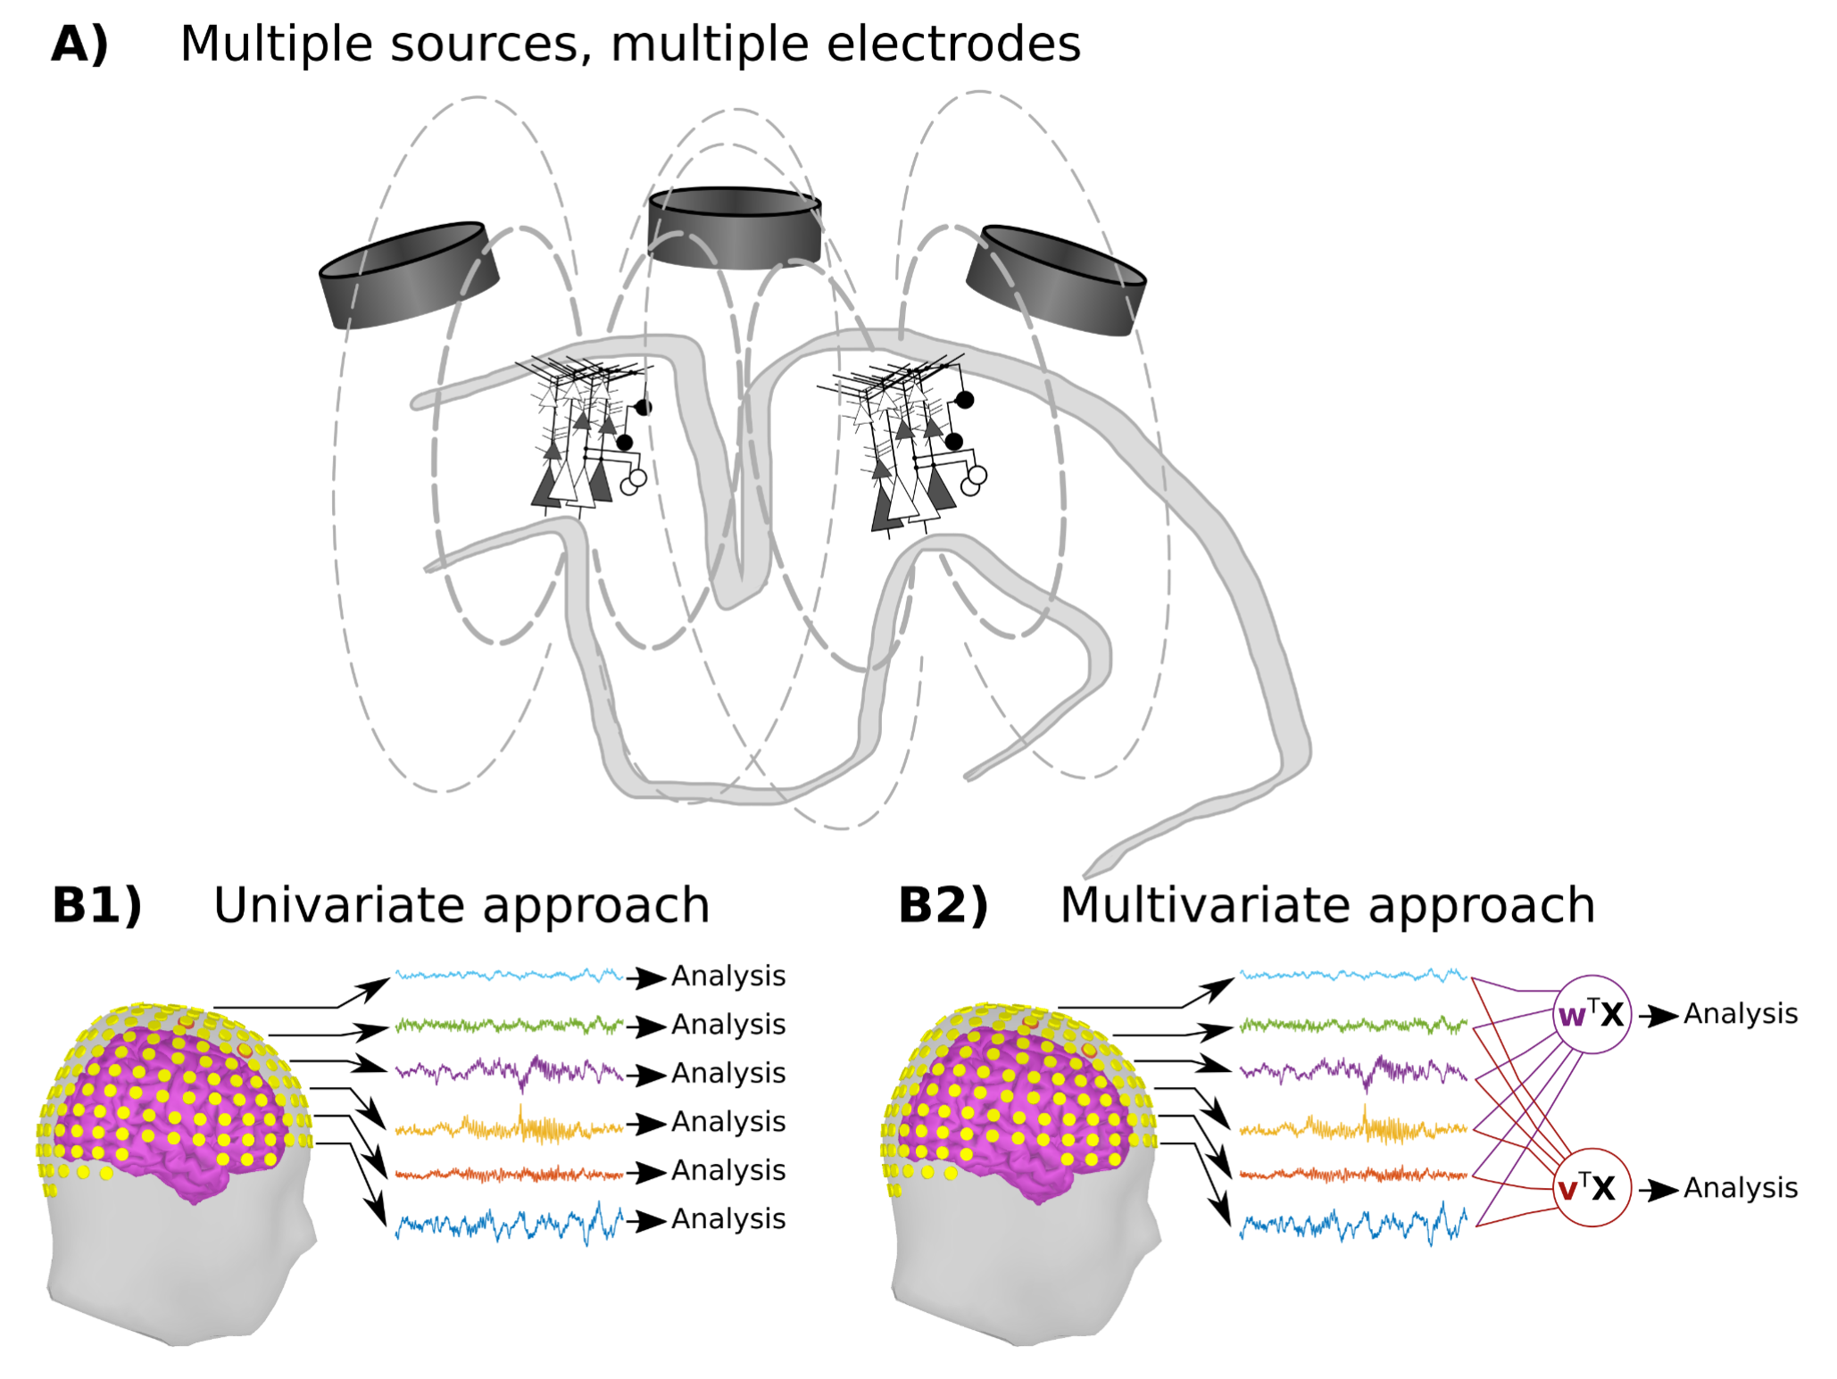
motivation
Cohen, 2022

Slide 7
But …
“[…] these arbitrary (and nearly always integer-based) cut-offs probably do fairly little damage to the final conclusions of each individual publication […]”
Notes:
As the two spectral bands have different anatomical origins (and thus at least slightly different projections onto the electrodes), their corresponding source-separation eigenvectors will decouple the spectral features better than a slope-based or single-channel-based algorithm

Slide 8
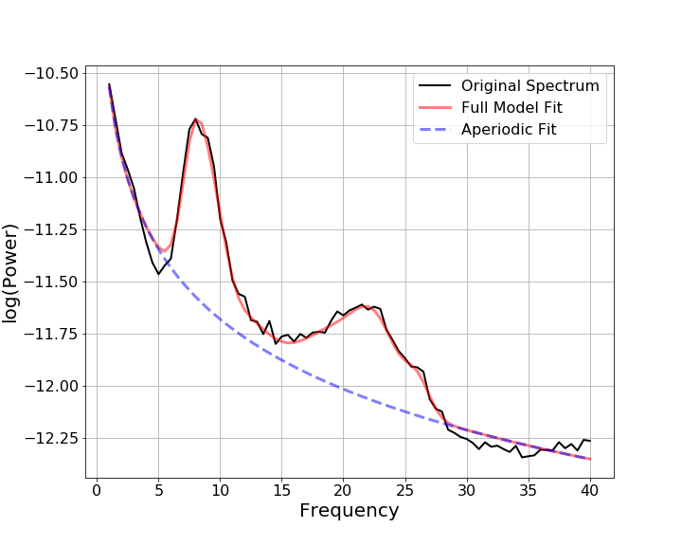
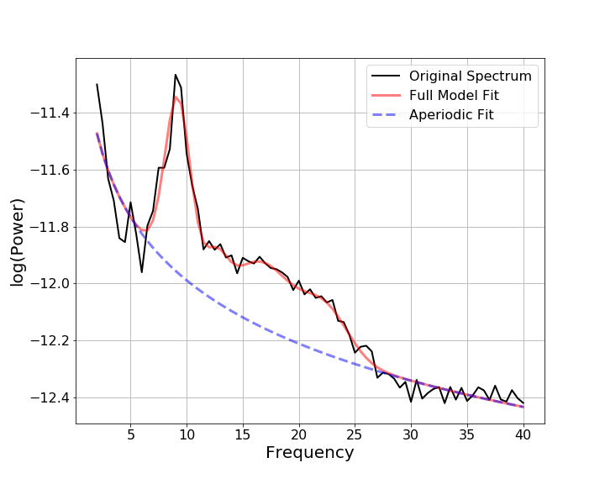
Goal
| individual beta band
PD 5 -off
PD 13 -off
Beta band?
Beta band?
UC San Diego Resting State EEG Data from Patients with Parkinson's Disease, OpenNeuro, 2020 (v. 1.0.3)

Slide 9
Get bounds
Assumptions
“Frequency bands” have similar spatiotemporal characteristics
Boundaries between bands can be defined as changes in those similarities
Signal with narrowband activity is expected

Slide 10
Method
| 5 steps
Create a channel covariance matrix using broadband data. (R)
In desired frequency range (e.g. 13-35 Hz) create channel covariance (S) per frequency bin
Compute generalized eigendecomposition (GED) on R&S -> spatial filter, maximally separates S from R
Compute pairwise squared correlations across “best” eigenvectors from all frequencies → matrix of eigenvector similarities
Apply cluster analysis to this matrix to identify “blocks” on the diagonal that have high similarities
MatLab code available: https://github.com/JuliusWelzel/StepUp-jc
Notes:
Loop over a range of frequencies (e.g., 2-100 Hz). At each frequency, create a channel covariance matrix using narrowband filtered data. This matrix is called ​S for signal. Compute the generalized eigendecomposition on ​S and ​R​, which identifies a spatial filter (a set of weights for all channels) that maximally separates ​S from ​R​, while ignoring any features that are common between the two matrices. The eigenvector of maximal separation is stored (Figure 1a).

Slide 11
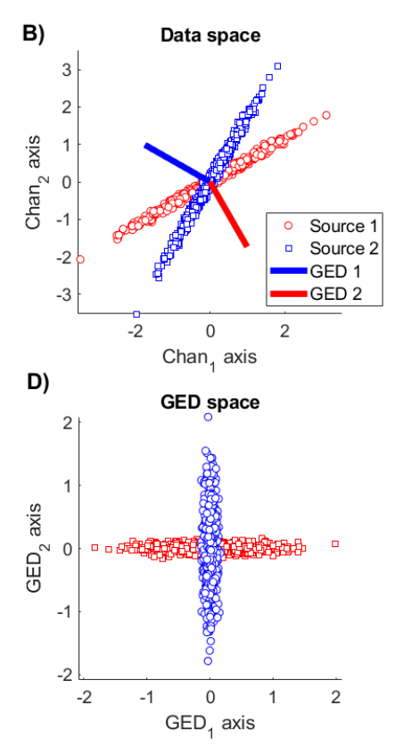
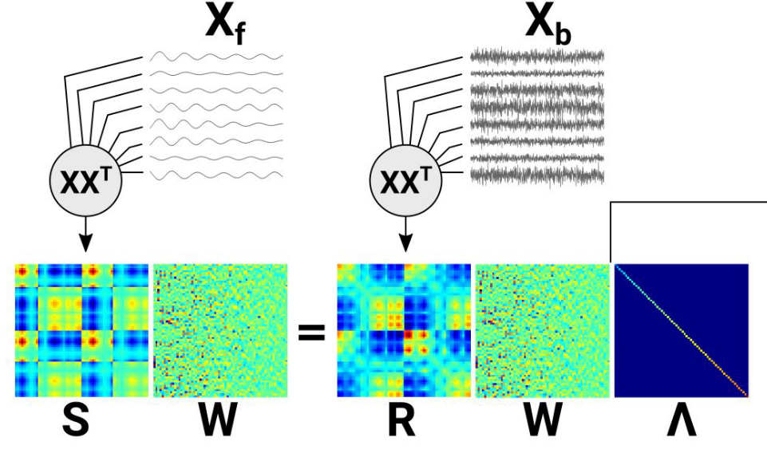
Pipeline 1
GED (R,S)
Notes:
Covariance matrices are used because they encode all pairwise linear relationships across the electrodes, thus allowing the method to leverage volume conduction and spatial autocorrelation to identify spatial patterns in the data, as opposed to the reduced signal-to-noise quality of a single electrode.
Thus, the column of with the largest associated eigenvalue is the spatial filter that maximizes the multivariate energy ratio between the narrowband and the broadband activity

Slide 12
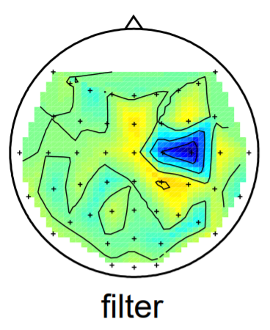
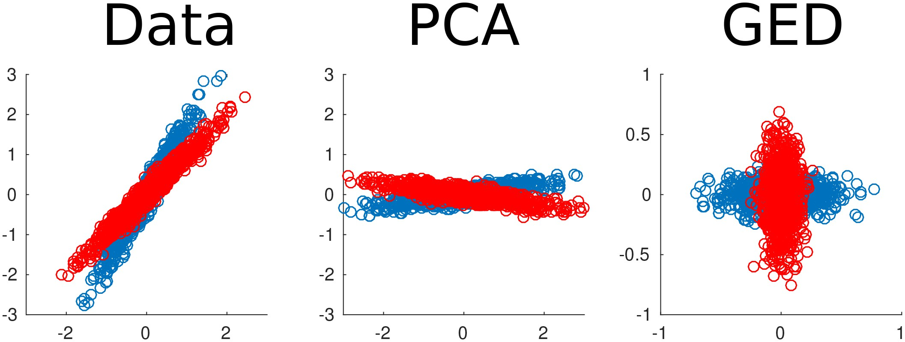
GED
| a spatial filter?
Cohen, eLife, 2017; Blankertz, eLife, 2007
Notes:
the distribution of samples after the filtering is shown. Note that both classes are uncorrelated at the same time; the horizontal (vertical) axis gives the largest variance in the red (blue) class and the smallest in the blue (red) class, respectively.

Slide 13
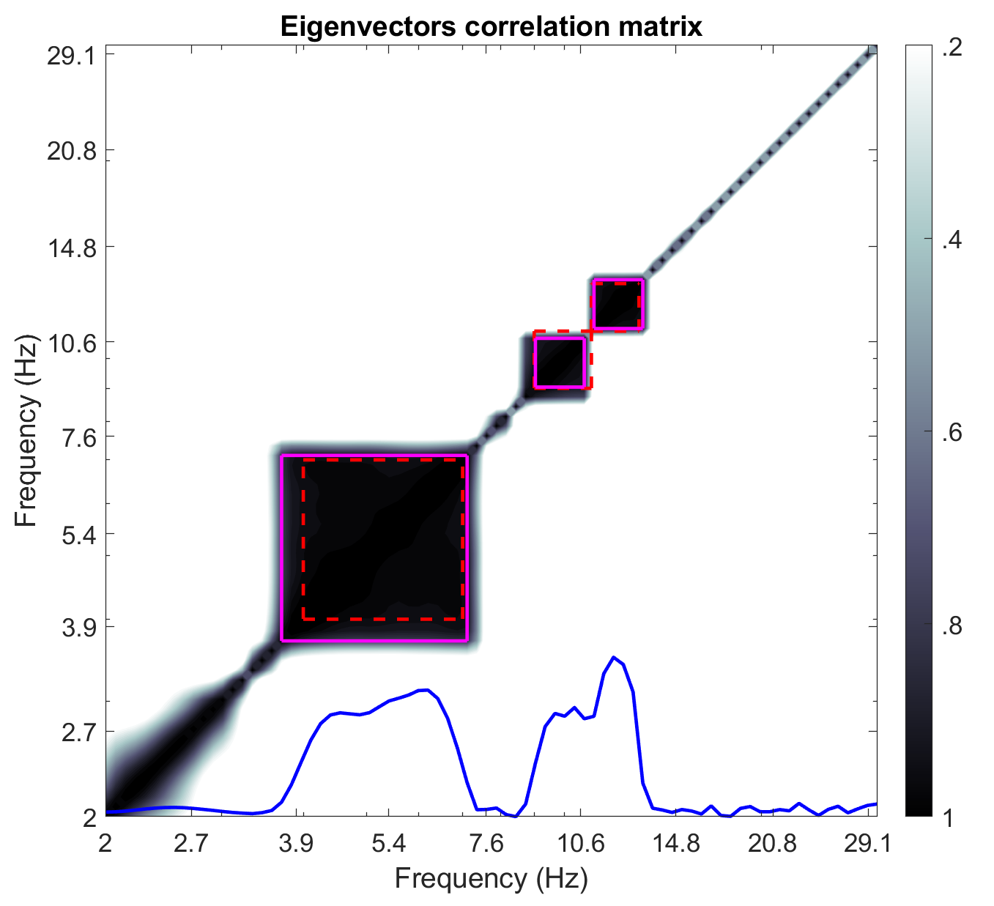
Pipeline 2
Eigenvector correlation matrix
Using top eigenvector from each frequency in [S] -> best separator
Clustering into frequency bins
Dbscan (density-based spatial clustering)
… a lot of tuning possibilities

Slide 14
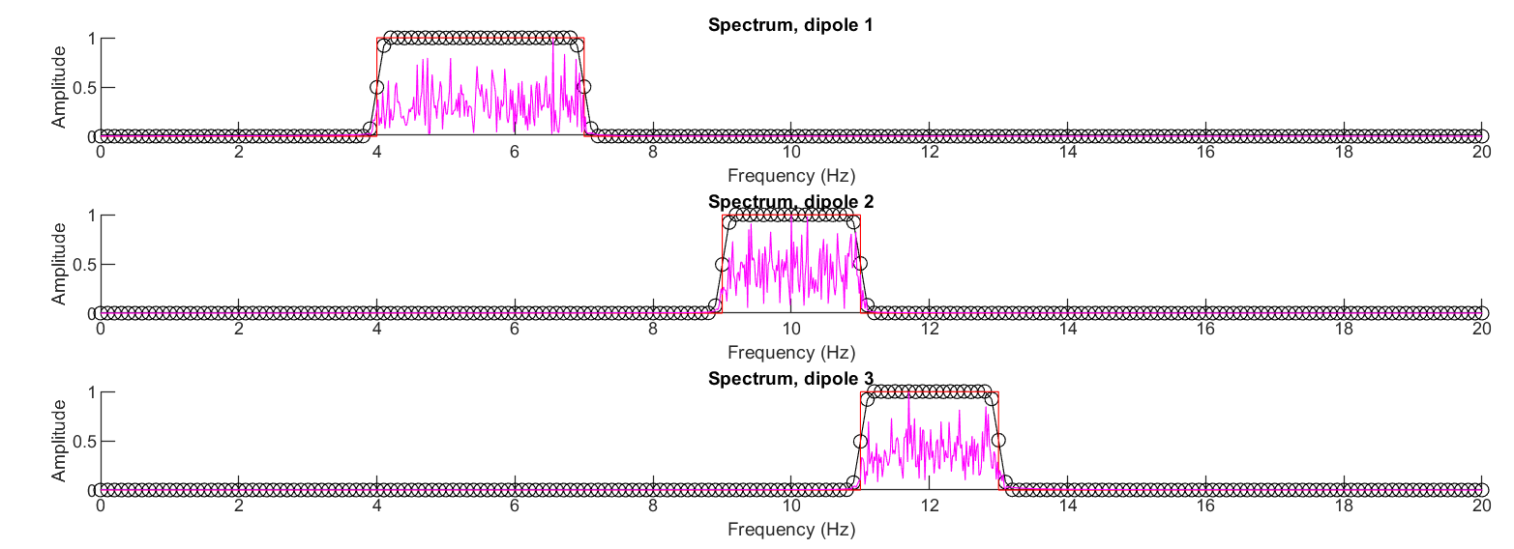
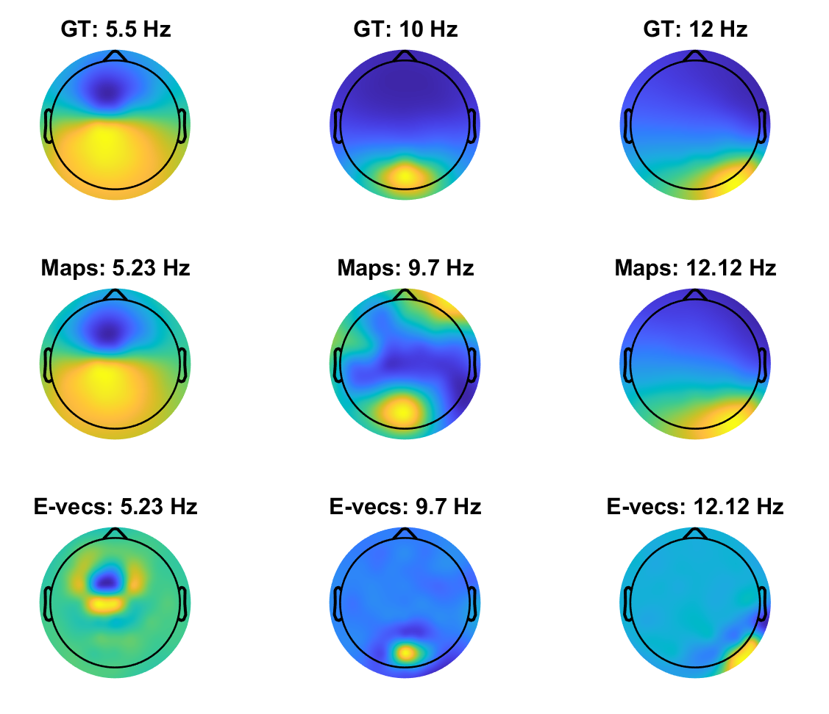
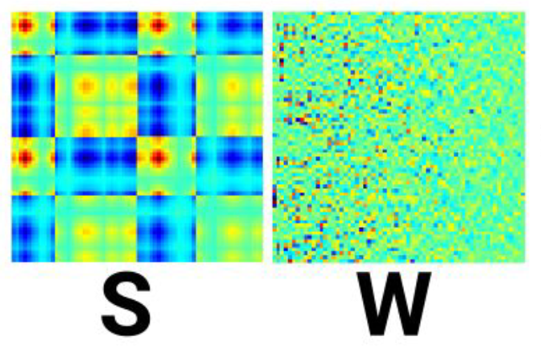
Interpretation
Notes:
Topographical maps show the PCA-averaged forward model for each cluster

Slide 15
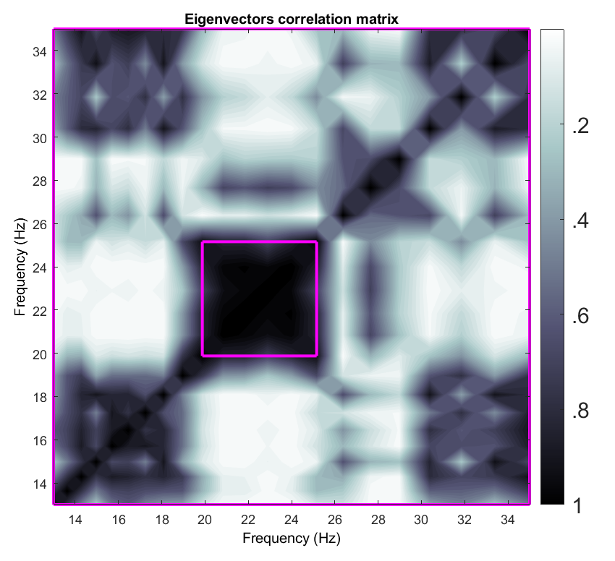
Does it work?
PD 5 -off
Beta band?

Slide 16
Does it work?
Correlation matrix of Eigenvectors at each Frequency
Maximal separates what exactly?
Narrowband from Broadband data!
In what regard?
Spatial characteristics
→ When two spectral bands have different anatomical origins , GED will decouple the spectral features

Slide 17
Does it work?
| sometimes yes
PD 5 -off
Beta band?
GED

Slide 18
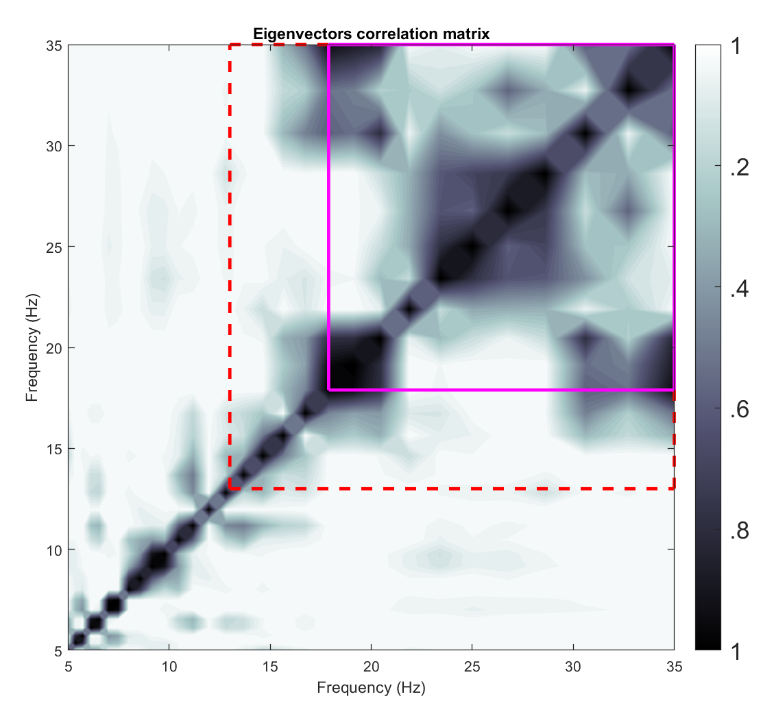
Does it work?
| sometimes no
PD 13 -off
Beta band?
GED
UC San Diego Resting State EEG Data from Patients with Parkinson's Disease, OpenNeuro, 2020 (v. 1.0.3)

Slide 19
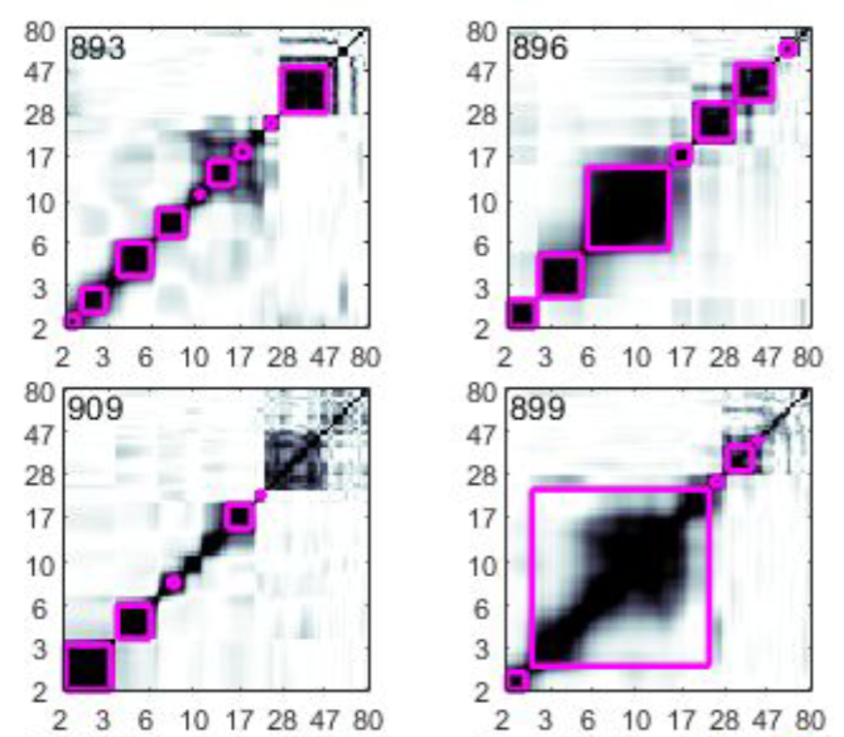
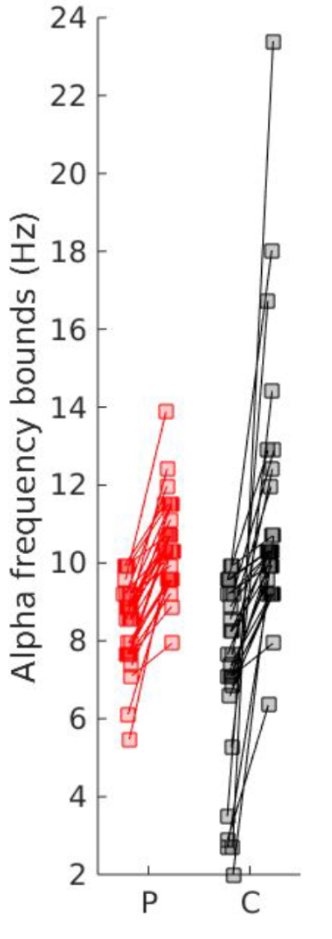
More PD data
| alpha band

Slide 20
Take home
GED can be used for the detection of individual frequency boundaries
Depending on spatial characteristics, the results can vary a lot
Clustering of eigenvector correlations seems unstable if correlation between different frequency bands

Slide 21
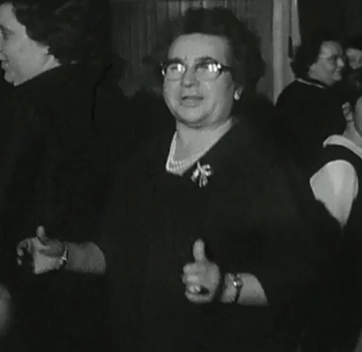
Thanks for listening carefully

Slide 22
Next JC
Next journal club:
15.03.23 10am (UTC+1)
Topics: Beta in PD, EEG & Gait, …
Slides and code
https://github.com/JuliusWelzel/StepUp-jc

Slide 23
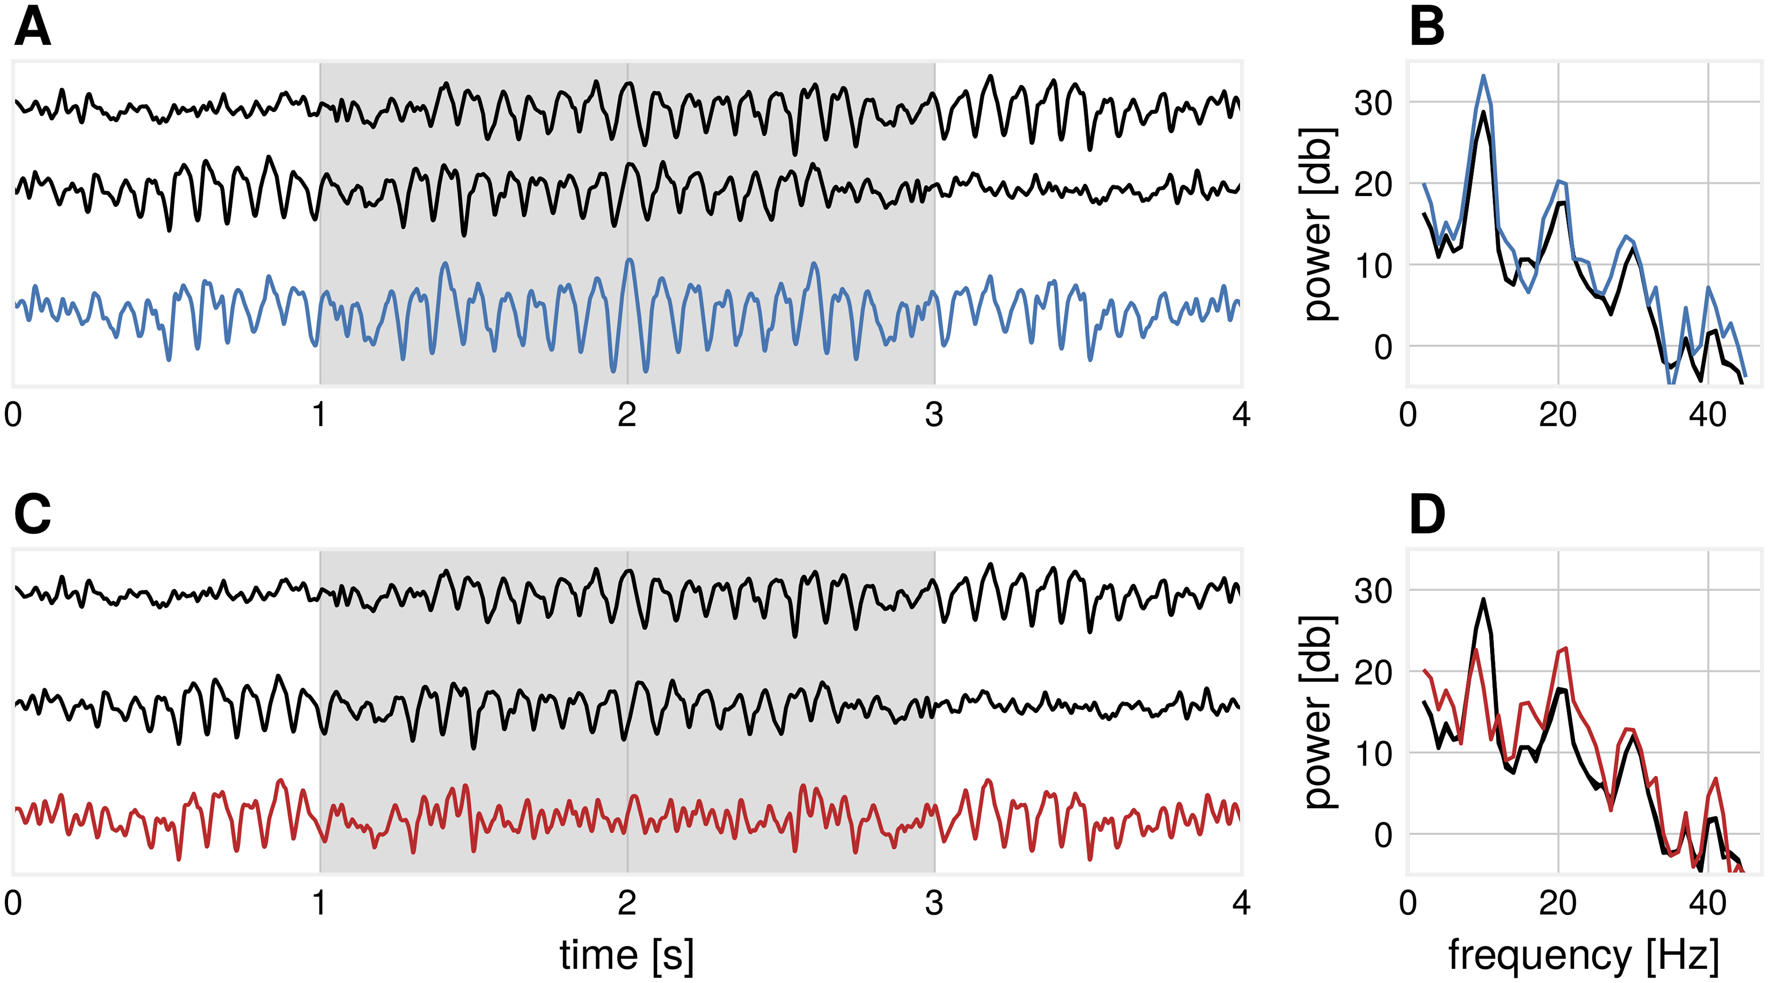
Non sinusoidal waveforms
Schaworonkow & Nikulin, PLOS Comp. Bio., 2019
Notes:
Fig 5. Illustration: The emergence of β-events from α-dominated sources.
(A) Two basis functions (black) mix with a temporal delay (σ = 15 ms) such that the α-power is enhanced in the compound signal (blue) during the segment marked in gray. (B) The corresponding power spectrum of the segment marked in gray for subplot (A) for basis functions (black) and compound signal, where both α- and β-spectral peaks are enhanced (blue). (C) Two basis functions (black) mix with a temporal delay (σ = 43 ms) such that the α-power is diminished in the compound signal (red) during the segment marked in gray. (D) The corresponding power spectrum of the segment marked in gray for subplot (C) for basis functions (black) and compound signal, where the α-peak is largely diminished and β-peak is enhanced (red).

Slide 24
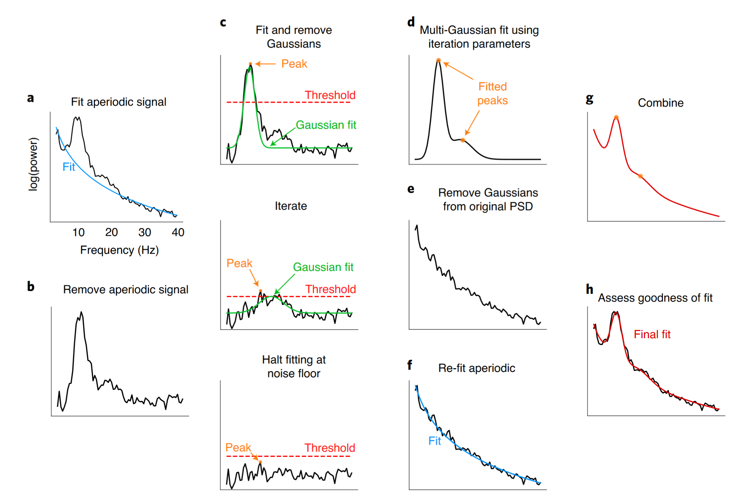
FOOOF
Notes:
Fig. 2 | Algorithm schematic on real data. a, The PSD is first fit with an estimated aperiodic component (blue). b, The estimated aperiodic portion of the signal is subtracted from the raw PSD, the residuals of which are assumed to be a mix of periodic oscillatory peaks and noise. c, The maximum (peak) of the residuals is found (orange). If this peak is above the noise threshold (dashed red line), calculated from the standard deviation of the residuals, then a Gaussian (solid green line) is fit around this peak based on the peak’s frequency, power and estimated bandwidth (Methods). The fitted Gaussian is then subtracted, and the process is iterated until the next identified point falls below a noise threshold or the maximum number of peaks is reached. The peak-finding at this step is only used for seeding the multi-Gaussian in d, and, as such, the output in d can be different from the peaks detected at this step. d, Having identified the number of putative oscillations, based on the number of peaks above the noise threshold, multi-Gaussian fitting is then performed on the aperiodic-adjusted signal from b to account for the joint power contributed by all of the putative oscillations together. In this example, two Gaussians are fit with slightly shifted peaks (orange dots) from the peaks identified in c. e, This multi-Gaussian model is then subtracted from the original PSD from a. f, A new fit for the aperiodic component is estimated—one that is less corrupted by the large oscillations present in the original PSD (blue). g, This re-fit aperiodic component is combined with the multi-Gaussian model to give the final fit. h, The final fit (red)—here parameterized as an aperiodic component and two Gaussians (putative oscillations)—captures >99% of the variance of the original PSD. In this example, the extracted parameters for the aperiodic component are: broadband offset = −21.4 a.u.; exponent = 1.12 a.u. Hz−1. Two Gaussians were found, with the parameters: (1) frequency = 10.0 Hz, power = 0.69 a.u., bandwidth = 3.18 Hz; (2) frequency = 16.3 Hz, power = 0.14 a.u., bandwidth = 7.03 Hz.

Slide 25

JPND call
A three year project:
Steps against the burden of Parkinson’s Disease (StepuP)

